Slide 1
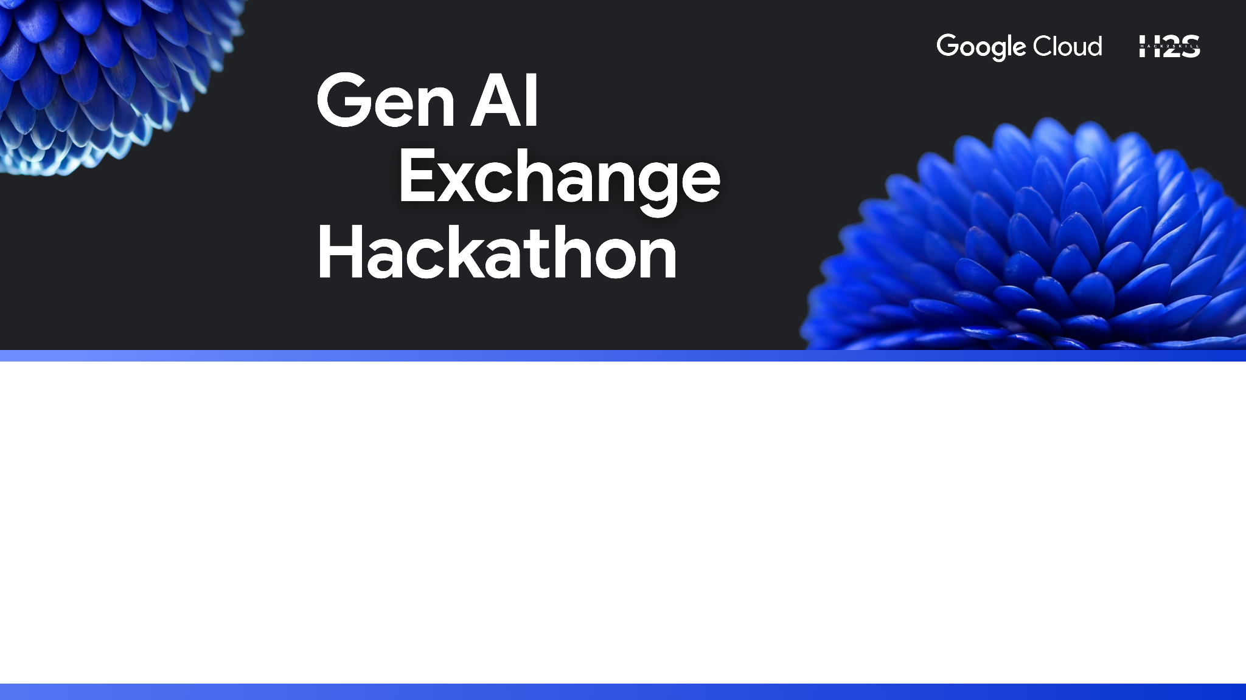
Team Name : JNR
Team Leader Name : Jayashre
Problem Statement : Generative AI for Demystifying Legal Documents

Slide 2
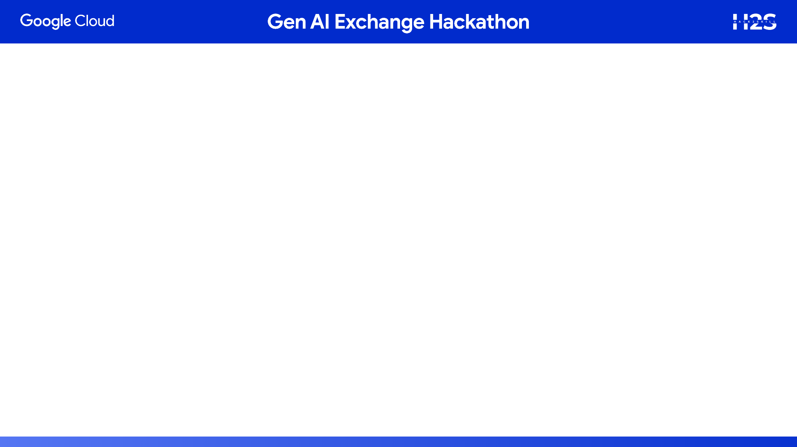
LegalEase AI – Demystifying Legal Documents with Generative AI
Problem:
Legal documents are complex, full of jargon, and inaccessible to students, freelancers, tenants and MSMEs.
Existing tools only summarize but fail to highlight risks or adapt to user context.
People sign contracts blindly -> financial & legal vulnerability.
Our Solution:
AI Powered assistive platform that:
Translates legal language into simple, plain English.
Offers an Interactive Q&A chatbot for clause-specific queries
Provides visual dashboards (timelines, flowcharts, risk overview)
Adapts explanations by user profile (Student, Tenant, Freelancer, MSME)
Supports multi-document comparison with risk scoring
Why it Stands Out?:
Not Just “summarization” -> risk alerts + visualization + personalization.
Positions itself as “Google Translate for Legal Docs, but with risk heatmaps and smart insights”
Designed as an assistive tool, not legal advice (safety + accountability built in)
Impact:
Empowers everyday people to understand & negotiate legal documents.
Saves time & money on lawyers for small stakeholders.
Builds trust and accessibility in legal processes.

Slide 3
LegalEase AI - Opportunity
How it Solves the Problem?
Simplifies legal jargon → makes contracts human-readable.
Flags unfair clauses (deposit refunds, hidden charges, one-sided terminations).
Interactive chatbot → lets users ask, “What does this mean for me?”
Comparison mode → shows how risks change across contract versions.
How Different from Existing solution?:
Current tools (DoNotPay, LawGeex, Legalese Decoder, RobinAI):
Focus on summarization or basic legal automation.
Limited risk interpretation and contextual personalization.
LegalEase AI difference:
Adds risk heatmap visualization on actual documents.
Adapts to user profiles (Student, Tenant, Freelancer, MSME).
Combines summaries, Q&A, and dashboards in one flow.
Unique Selling Proposition (USPs)
First-of-its-kind assistive AI legal translator with:
Risk heatmap overlays (instant visual understanding).
Profile-based explanations (tailored insights).
Confidence-level indicators (transparent about AI reliability).
Positions itself as “Google Translate for Legal Docs + Risk Radar.”
Notes:
Current tools (DoNotPay, LawGeex, Legalese Decoder, RobinAI):
Focus on summarization or basic legal automation.
Limited risk interpretation and contextual personalization.
LegalEase AI difference:
Adds risk heatmap visualization on actual documents.
Adapts to user profiles (Student, Tenant, Freelancer, MSME).
Combines summaries, Q&A, and dashboards in one flow.

Slide 4
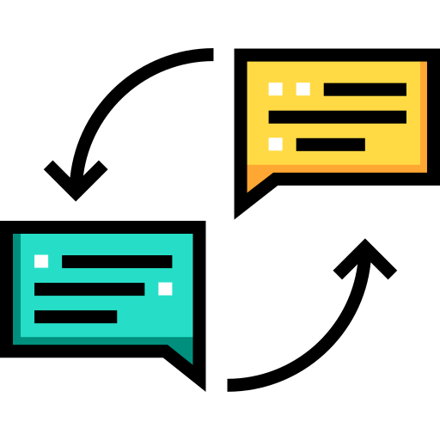



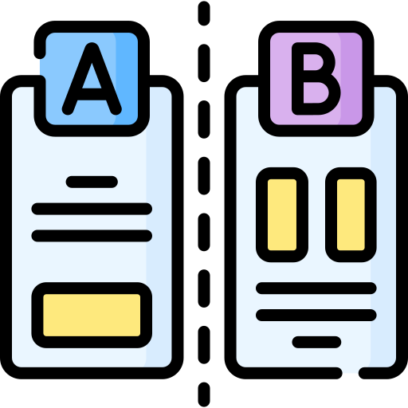

LegalEase AI - Features
Plain Language Translation
Converts dense legal jargon into simple, easy-to-read text.
Risk Heatmap Overlay
Highlights risky clauses directly in the PDF with red/yellow/green markers.
Interactive Legal Chatbot
Context-aware answers, linked back to the original clause.
User Profile Tailoring
Same clause explained differently based on user needs.
Multi Document Comparison
Compare contract versions side by side.
Transparency & Safety Layer
Confidence-level indicators on each explanation.

Slide 5
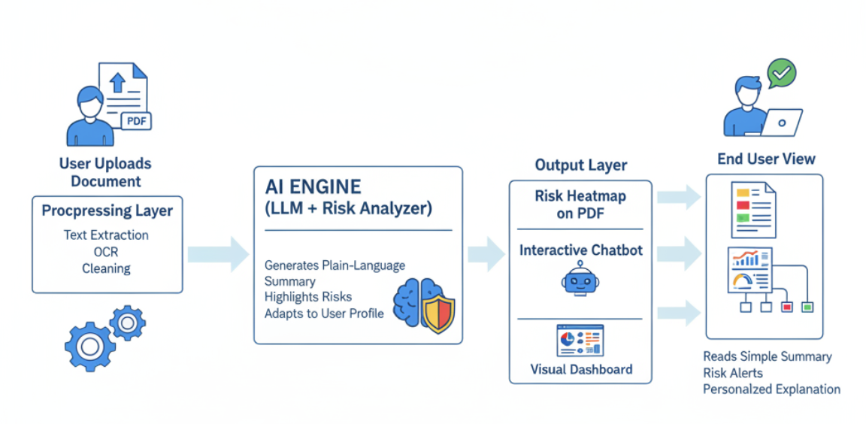
LegalEase AI – Use Case Diagram

Slide 6
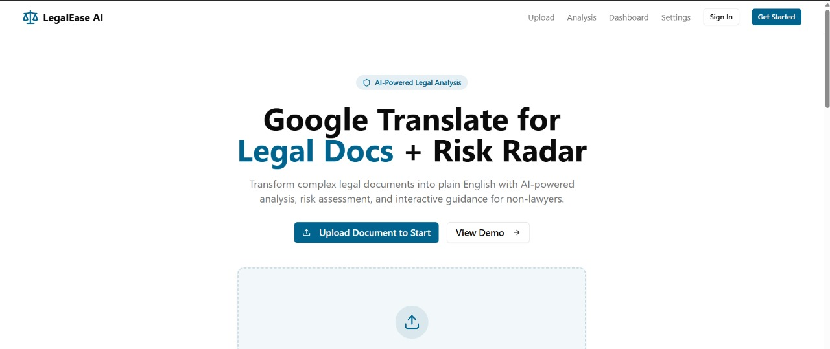
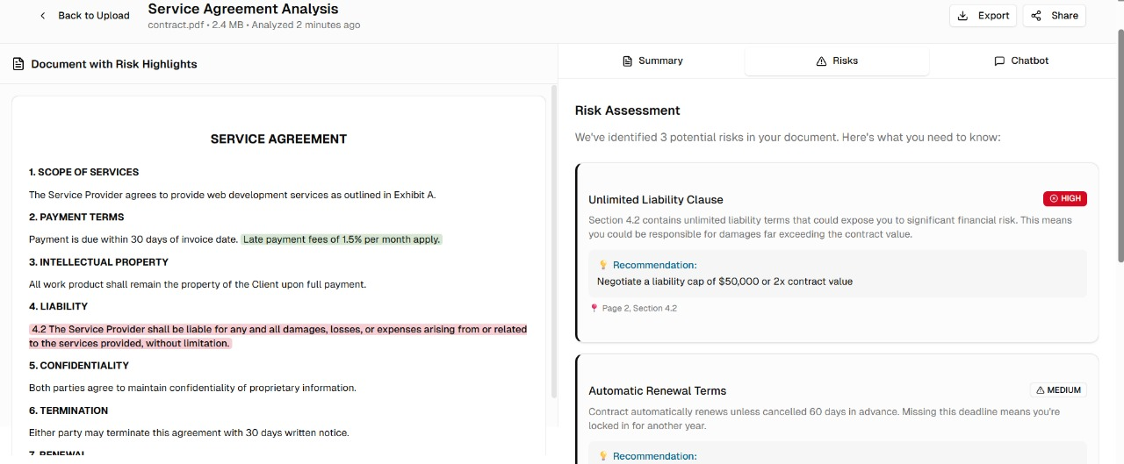
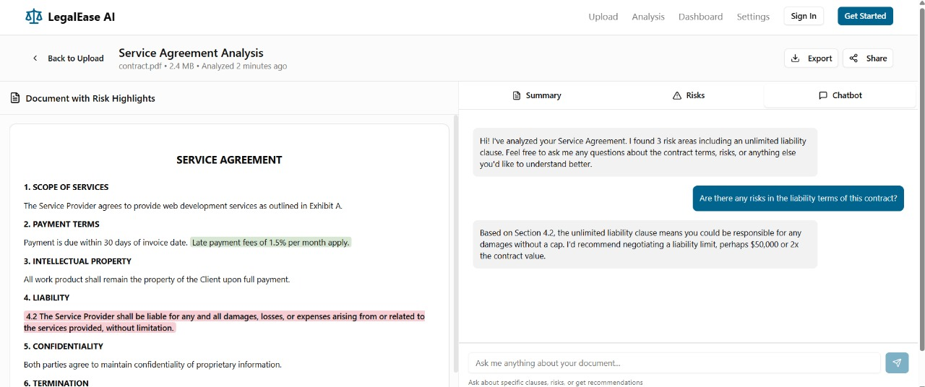
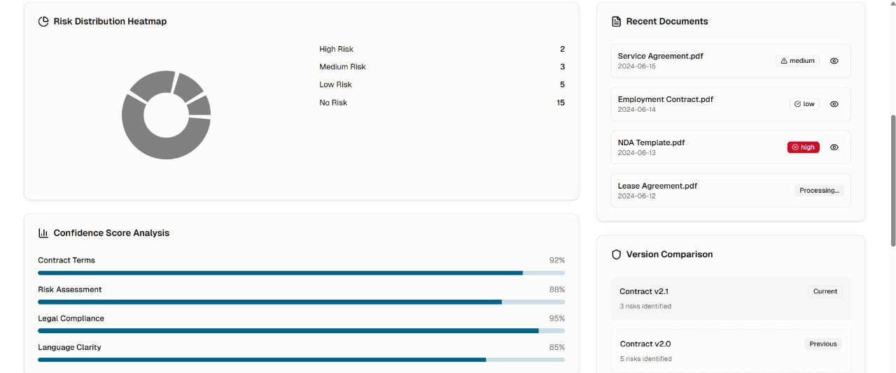
LegalEase AI – Wireframes/Mockups

Slide 7
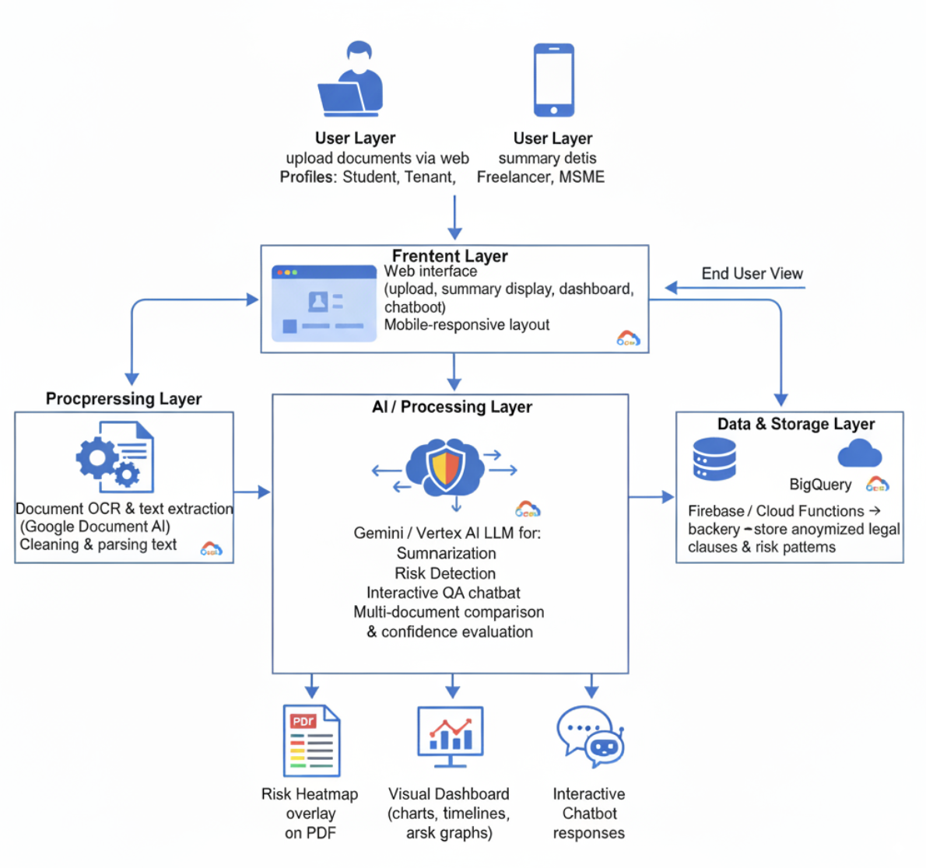
LegalEase AI – Architecture Diagram

Slide 8
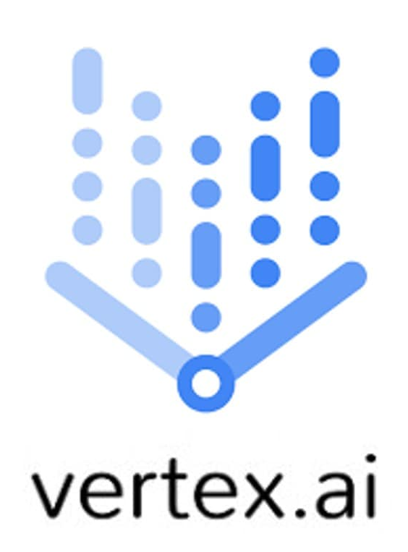




LegalEase AI – Tech Stack
AI & ML
Gemini / Vertex AI LLM → Summarization, risk detection, interactive Q&A
Generative AI → Plain-language explanations
AI-based Document Comparison → Highlights clause differences & risks
Document Processing
Google Document AI → OCR & text extraction
Preprocessing scripts → Clean & structure text
Backend & Cloud
Firebase + Cloud Functions → Real-time storage & serverless backend
BigQuery → Clause/risk pattern database
Frontend & UI
Responsive Web Interface → Upload, dashboards, chatbot
Visualizations → Risk heatmap, charts, timelines
Security & Compliance
Encrypted document storage, Firebase Auth
Disclaimer & confidence
Integration Tools
Gemini Code Assist → Accelerates prototype development
Vertex AI Search → Clause similarity & comparison

Slide 9
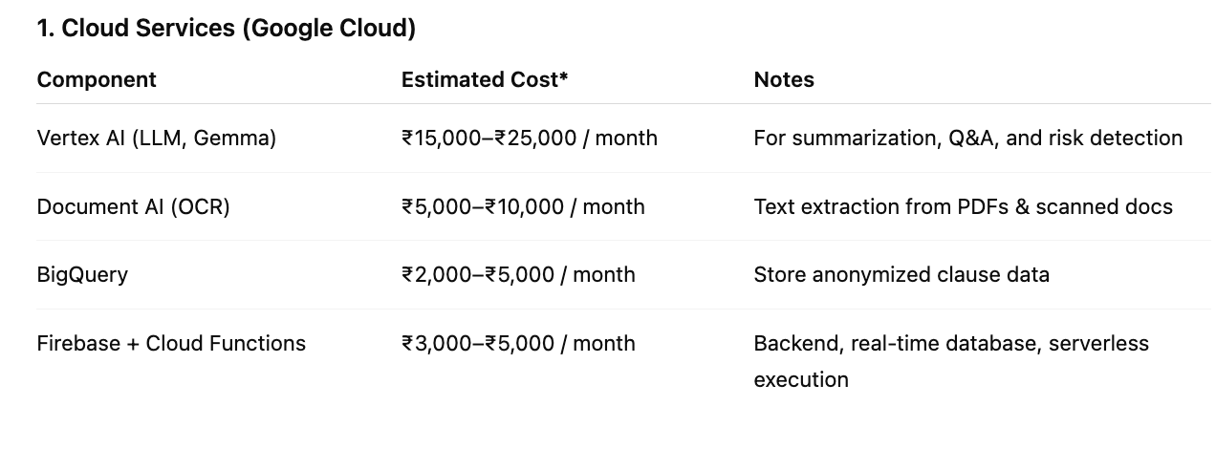
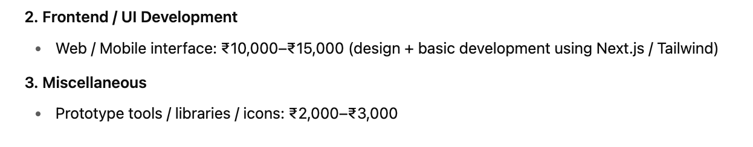
LegalEase AI – Estimated Cost of Implementation
Assumptions
Costs assume hackathon scale / prototype stage.
Production-grade scaling may increase costs.
AI usage is optimized for prototype & demo purposes.

Slide 10



LegalEase AI – Links
Github
Website
Youtube

Slide 11


